Slide 1
Welcome to our Back to School Curriculum Night!

Slide 2
The Plan for Tonight
A little about our teaching team
The GWA approach to education
Our class Essential Agreements
The year ahead academically
Communication
How you can support
Homework

Slide 3
A Little About Us
Krista McCauley
USA
KG2 for 8 years
KG1 for 3 years
Jinky Barriga
Philippines
4th Year at GWA
2 Children

Slide 4
GWA Approach to Education
Inquiry based
Integrated
Challenged according to what students are ready to learn next (developmental approach)
Focus on differentiation, activity based, small group and individualized learning

Slide 5
Role of Play in Early Childhood
Play provides opportunities to explore, create, develop social skills, role-play, express themselves, learn about emotions, release stress, test limits, take risks, and enjoy themselves.
Play supports both the academic and social aspects of learning through a child’s perspective.
Teacher’s role is to act as the facilitator; to guide students in generating their own questions about their learning and help them locate the resources they need to find their own answers.

Slide 6
How We Know What Students Have Learned
Prior knowledge to drive inquiry
Assessment (authentic, observations, discussions, work samples, not always paper and pencil, etc.)
Process oriented more often than product (reflection of learning)
Portfolios (show progress throughout the year)
Student Led Conferences

Slide 7
Class Essential Agreements
Embody the Learner Profile
Our classroom essential agreements foster safety, respect, and shared responsibility
What we are encouraging and how you can help at home (consistency)

Slide 8
The Year Ahead
Units of Inquiry overview
Who We Are: “Our Senses”
Central Idea: We use our senses to find out about ourselves, each other and the environment
We will be inquiring into the following:
The five senses
How we use our senses to learn about the world
Why senses are important and the impact of their absence
How the World Works: “Water”
Sharing the Planet: “Minibeasts”
How We Express Ourselves: “Tell Me a Story”

Slide 9
The Year Ahead Academically
Approach to Language Arts and Math
Language Arts:
Listening and Speaking
Reading
Writing
Viewing and Presenting
Math:
Number
Shape and Space
Measurement
Pattern and function
Data Handling

Slide 10
Specialist Subjects in EC
ICT – computer lab, computers in indoor discovery hall, iPads, interactive whiteboard
Library
PE
Music
Swimming
Art

Slide 11
Communication
Many ways to be in touch including face-to-face, school newsletters, bulletin boards, email, phone
Check the Weebly frequently for news, updates, monthly calendars
Ask questions or raise concerns as they arise, open door policy

Slide 12
Supporting Learning at Home
How parents can help
Help foster independence and responsibility
Dressing themselves, carrying their school bag, saying goodbye at the door, putting their bag in the cubby
No official homework in KG1
Talk to your child about their day and work brought home; ask specific questions rather that general
Encourage questioning and inquiry through modeling

Slide 13
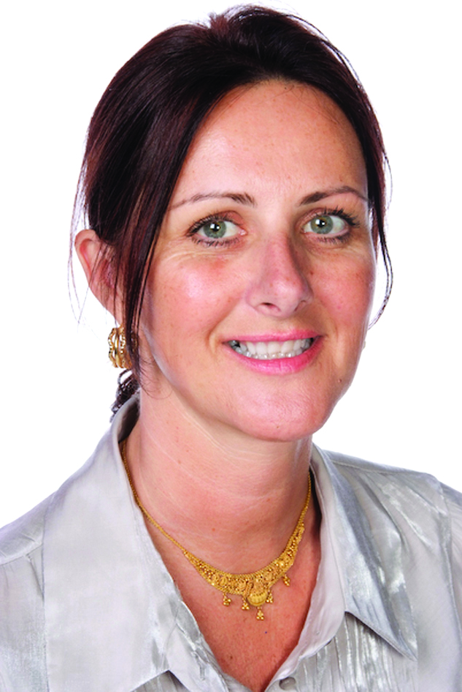
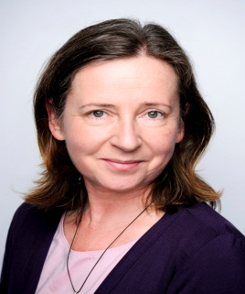
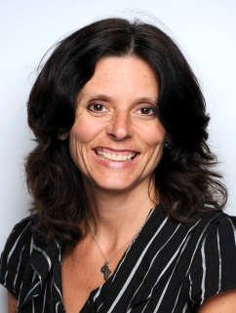
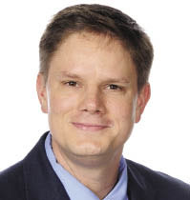
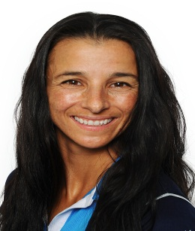
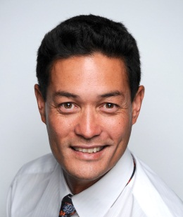
Early Childhood Specialist Team
Anita Henry Library teacher
Neal Clark
ICT teacher
Katie
Morton-
Shepherd
PE Teacher
Margaret Sikora
Music teacher
Nina Garza
EC Counsellor
Martin Hamilton
Swimming teacher
Emma Hamilton
Art teacher
Darlene Huson
Elementary
Vice Principal

Slide 14
A Few Reminders-Your help is greatly appreciated
8:15 start time
1:30 dismissal
Please say your goodbyes at the door
Let me know changes in your child’s transportation
Label all of your child’s items
Please supply your child with cutlery for their food
Please return white folders and library books

Slide 15
Thank you for coming!

